Slide 1

Optimizing Perovskite Solar Cell Performance
MINOR PROJECT -1
2024-2025
Team Group - 1
JIIT’62

Slide 2

Team Members
• Nishant Dwivedi -22102004 ( A1)
• Vibhor Yadav -22102005 ( A1)
• Priyanshu Agarwal -22102236 ( A8)
Supervisor
Dr. Rishibrind Kumar Upadhyay
Senior Grade Assistant Professor

Slide 3

Introduction
Importance in Renewable Energy
Solar cells are key to reducing greenhouse gas emissions and meeting global energy demands sustainably.
Perovskites have the potential to complement or replace silicon in applications where cost and versatility are critical.
What are Silicon-Based Solar Cells?
Silicon-based solar cells are the most widely used photovoltaic technology today, dominating the market for decades.
They rely on crystalline silicon as the primary material for converting sunlight into electricity.
Highly reliable, they achieve efficiencies of 15–25% under standard conditions, but their performance is nearing theoretical limits (~33%).

Slide 4
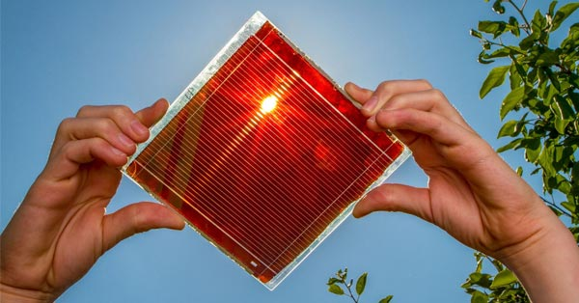
What are Perovskite Solar Cells?
Perovskite solar cells (PSCs) are an innovative type of photovoltaic device that use perovskite-structured materials as the light-harvesting layer.
Known for their rapid efficiency advancements, lightweight nature, and potential for low-cost manufacturing, they represent a breakthrough in solar technology.
Perovskite vs. Silicon Solar Cells
Silicon Solar Cells: Mature technology, but production is energy-intensive and costly. Their rigid structure limits applications like flexible and lightweight devices.
Perovskite Solar Cells: Offer higher efficiency potential, simpler fabrication methods, and the ability to integrate with flexible or transparent substrates.
.

Slide 5

Objectives and Problem Statement
Objectives:
To enhance the efficiency of perovskite solar cells.
To develop lead-free materials for perovskite solar cells to make them environmentally friendly.
Problem Statement:
Current perovskite solar cells face challenges of toxicity (e.g., lead content) and efficiency, limiting their commercial viability. Our project aims to address these issues, making them a more sustainable option for the future.

Slide 6

GLOBAL SCOPE
Justification: The project addresses global energy challenges by improving the efficiency and environmental sustainability of solar cells, contributing to clean energy initiatives worldwide.
Impact: Global adoption of perovskite solar cells could revolutionize the renewable energy sector, reducing reliance on non-renewable sources and mitigating climate change.

Slide 7
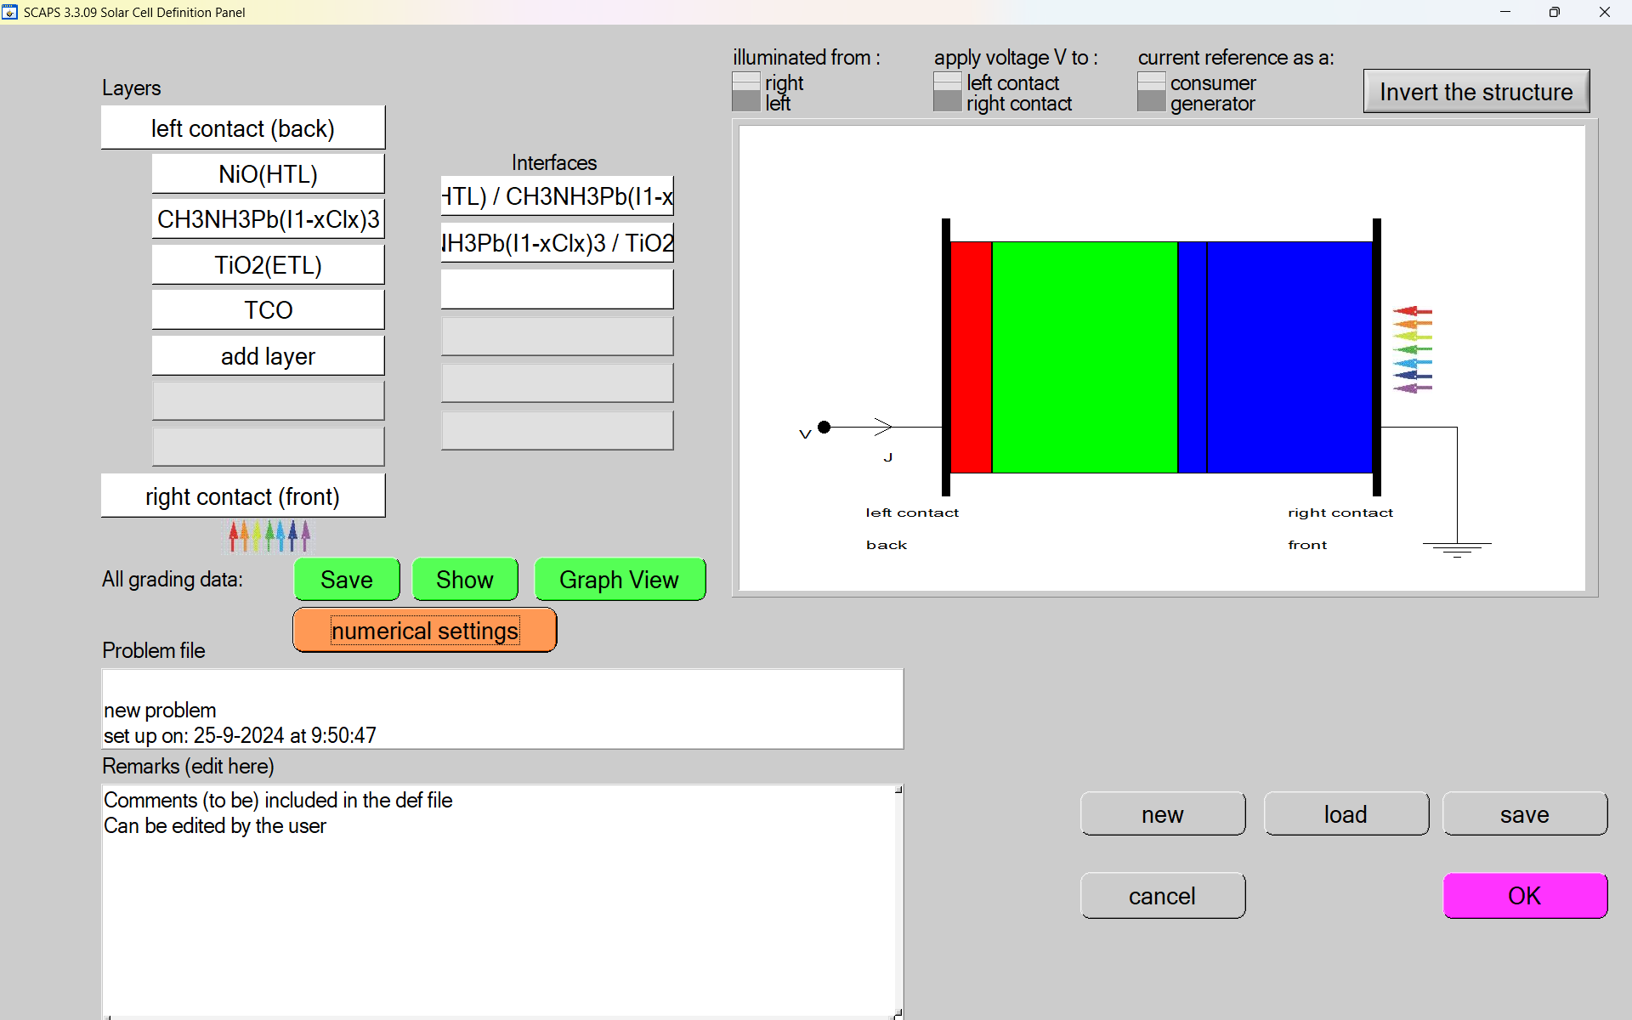
Methodology Overview
Material Research: Focus on identifying non-toxic materials to replace lead.
Simulation: Using advanced simulation tools(SCAPS-1D) to model the behavior and efficiency of perovskite cells.
Fabrication: Developing a prototype to test material properties and performance.

Slide 8

Group Contributions Overview
Vibhor Yadav: Methylammonium lead halide CH₃NH₃Pb(I₁₋ₓClₓ)₃(Perovskite) –Lead Based Simulation and optimization.
Nishant Dwivedi: CH₃NH₃SnBr₃ (methylammonium tin bromide)– Lead Free Simulation and optimization.
Priyanshu Agarwal: "Lead-Free Double Perovskite" Cs₂TiBr₆–Simulation and optimization.

Slide 9
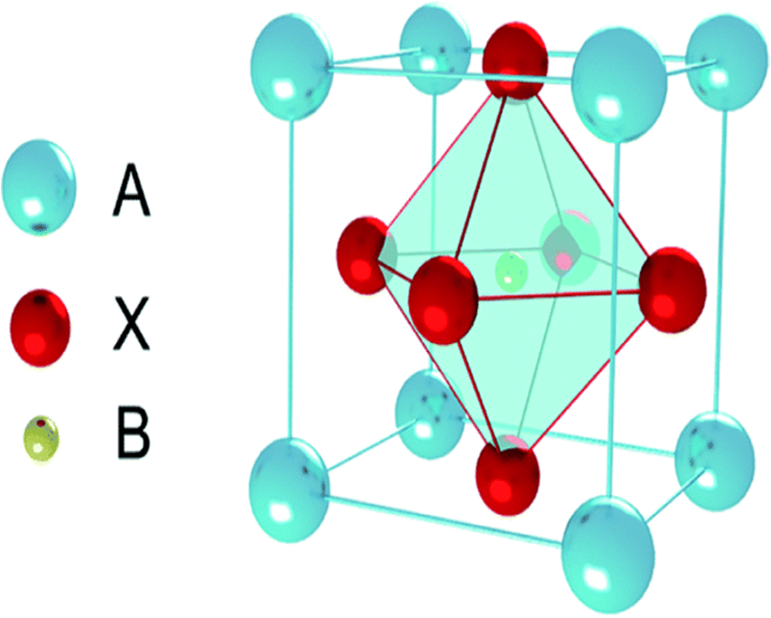
Member 1's Material and Results
Material Overview
Methylammonium lead halide (CH₃NH₃Pb(I₁₋ₓClₓ)₃) is a hybrid organic-inorganic material used in perovskite solar cells. It has a unique perovskite crystal structure, where lead (Pb) is surrounded by halide ions (Iodine and Chlorine) and the methylammonium (CH₃NH₃) organic cation.
Key Points:
High Efficiency: Excellent light absorption and power conversion, making it a promising alternative to silicon solar cells.
Tunability: The halide composition (Iodine and Chlorine) can be adjusted to fine-tune its optical properties.
Low-cost: Can be produced using simple solution-based methods at low temperatures.
Challenges: Instability (degradation from moisture, heat) and lead toxicity, which are being addressed by researchers.

Slide 10
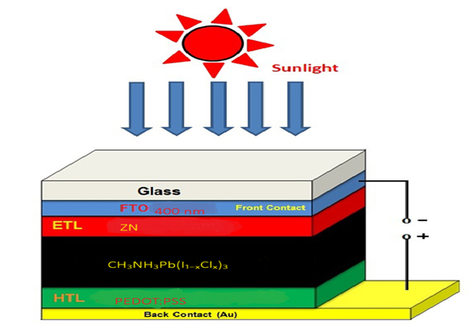
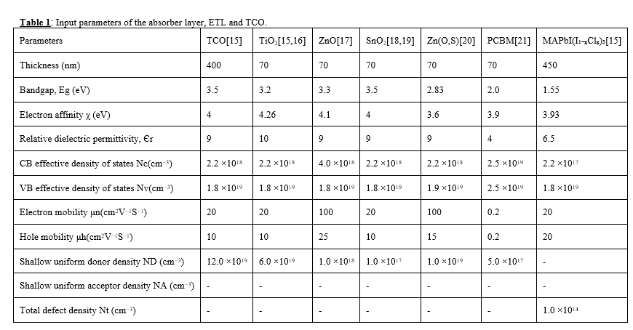
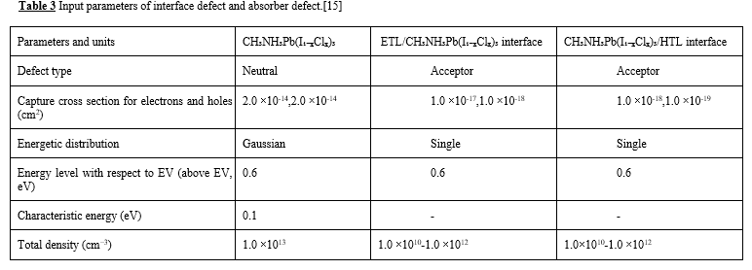
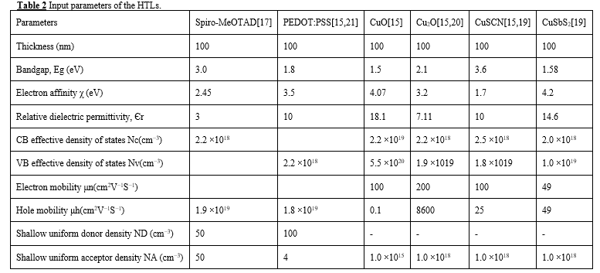
Simulation Setup and Parameter Changes

Slide 11
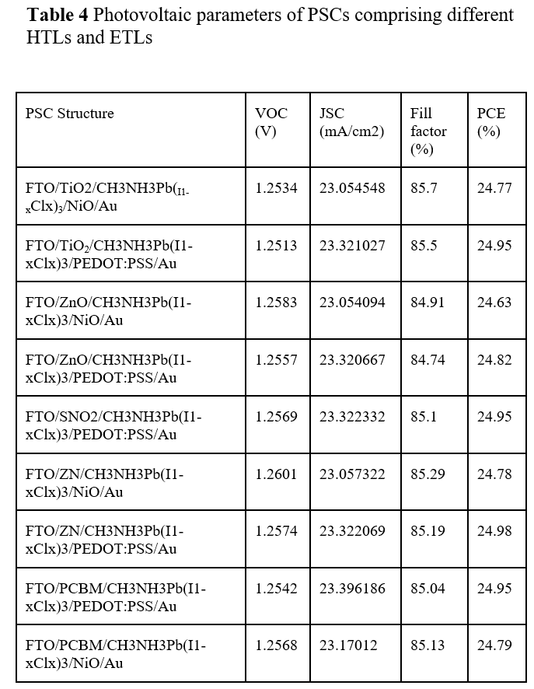
Results and Final Efficiency
The maximum efficiency, FF, J_{SC}, and V_{oc} 24.98%, 85.19%, 23.32 mA/cm² and 1.257 volt respectively attained by perovskite CH₃NH₃Pb(I₁₋ₓClₓ)₃ using PEDOT: PSS, Zn (O, S), as hole transport and electron transport layer materials respectively.

Slide 12
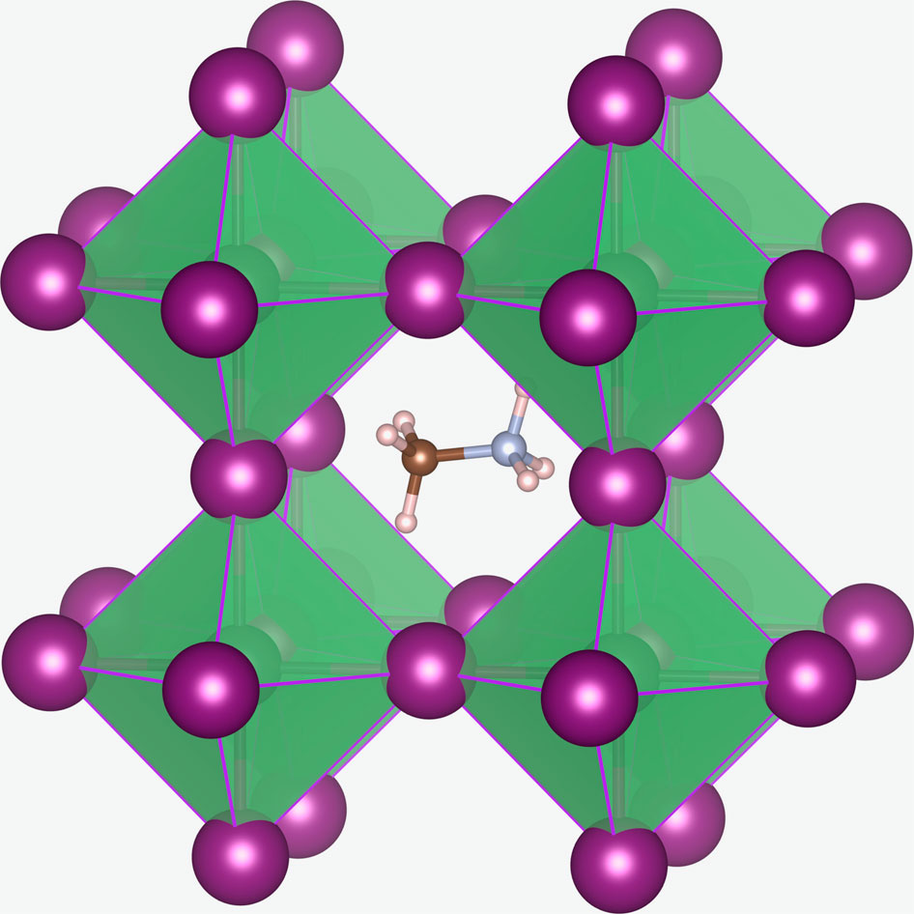
Member 2's Material and Results
Material Overview
Methylammonium tin bromide (CH₃NH₃SnBr₃) is a hybrid organic-inorganic perovskite material, where tin (Sn) is surrounded by bromide ions (Br), and methylammonium (CH₃NH₃) acts as the organic cation. It is used as a lead-free alternative in perovskite solar cells.
Key Points:
Lead-Free: Replaces lead with tin (Sn), addressing concerns about lead toxicity in solar cells.
Good Efficiency: Offers promising light absorption and potential for decent power conversion efficiency, although slightly lower than lead-based perovskites.
Tunability: The bromide composition can be adjusted, making it possible to tailor its optical and electronic properties.
Low-Cost: Similar to other perovskite materials, it can be processed using solution-based methods, reducing production costs.
Challenges:
Lower Stability: Tin-based perovskites generally show lower stability compared to lead-based perovskites.
Efficiency Gap: While still efficient, it generally underperforms in comparison to lead-based materials, making it a subject of ongoing research.
Moisture Sensitivity: Like other perovskites, it is sensitive to moisture, which can lead to degradation.

Slide 13
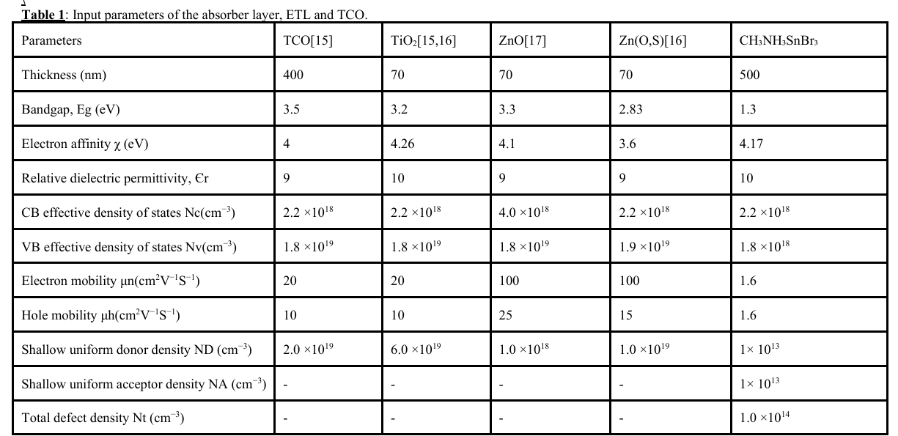
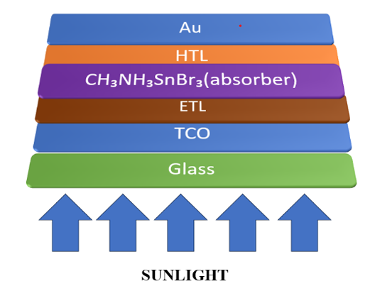
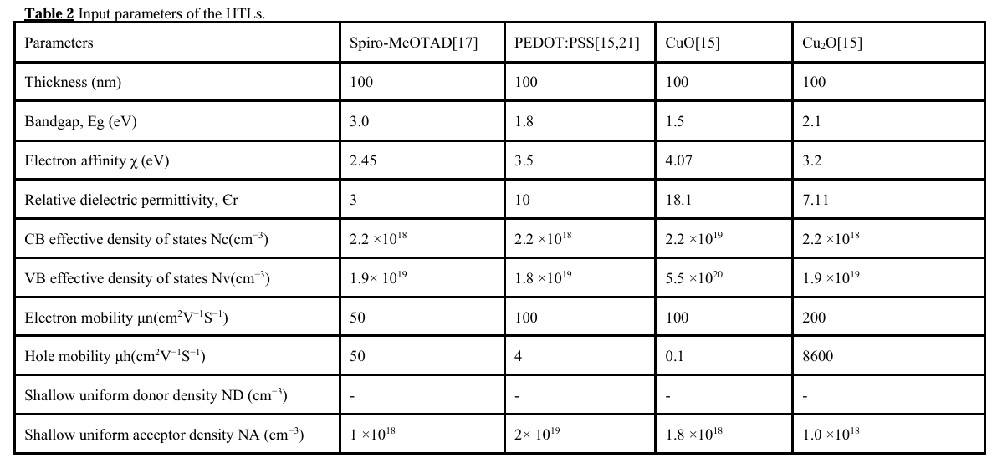
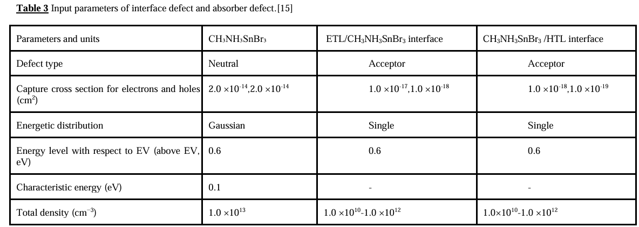
Simulation Setup and Parameter Changes

Slide 14
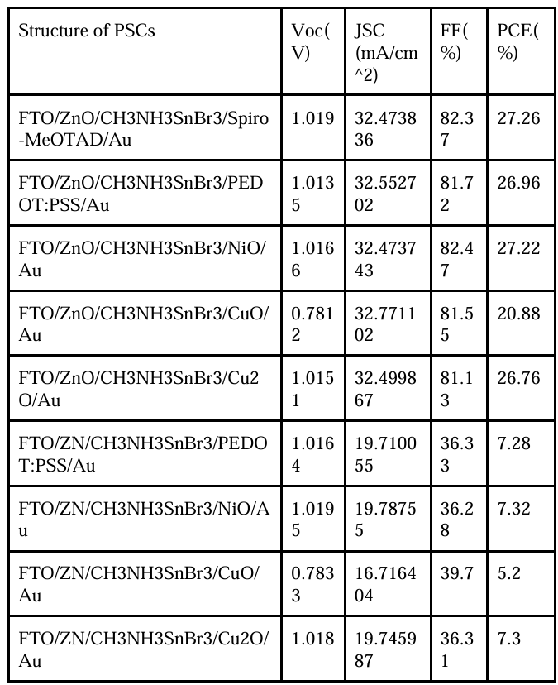
Results and Final Efficiency
Considering all optimization parameters, the CH₃NH₃SnBr₃ based perovskite solar cell achieved a maximum PCE of 27.26%, with Voc of 1.019 V, Jsc of 32.47 mA/cm², and FF of 82.37%.

Slide 15
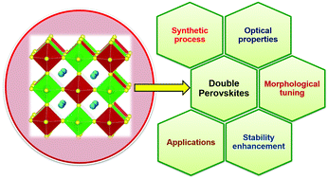
Member 3's Material and Results
Material Overview
Cs₂TiBr₆ is a perovskite-like compound made up of cesium (Cs), titanium (Ti), and bromine (Br) ions. It has a similar crystal structure to traditional perovskite materials but with a different metal (titanium) instead of lead. This compound has gained attention due to its potential use in solar cells and other optoelectronic devices, offering a non-toxic alternative to lead-based perovskites.
Structure: It adopts a 3D perovskite structure, where titanium is coordinated by bromine anions, and cesium acts as a cation.
Properties: Cs₂TiBr₆ exhibits promising light absorption properties and stability, making it a good candidate for photovoltaic applications.
Advantages: The absence of lead makes it environmentally friendly, and its stability in moisture improves its potential for long-term applications.

Slide 16
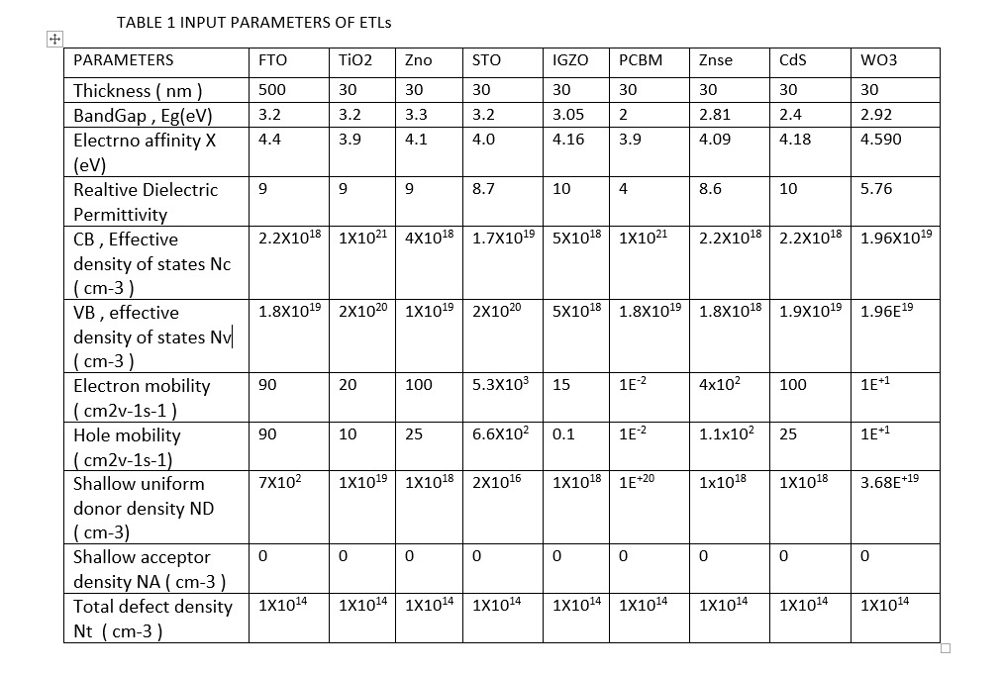
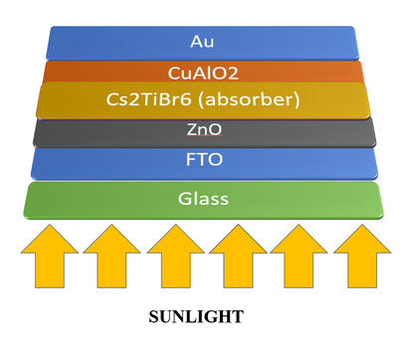
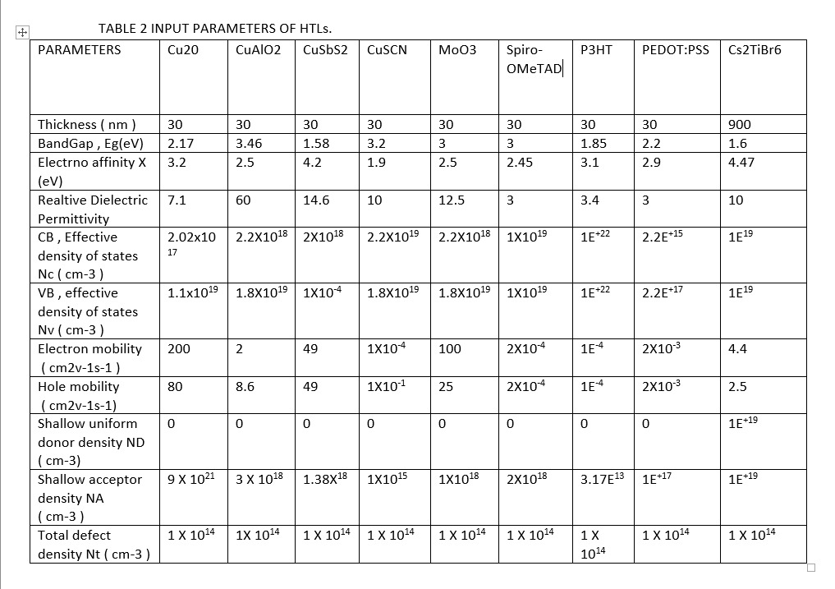
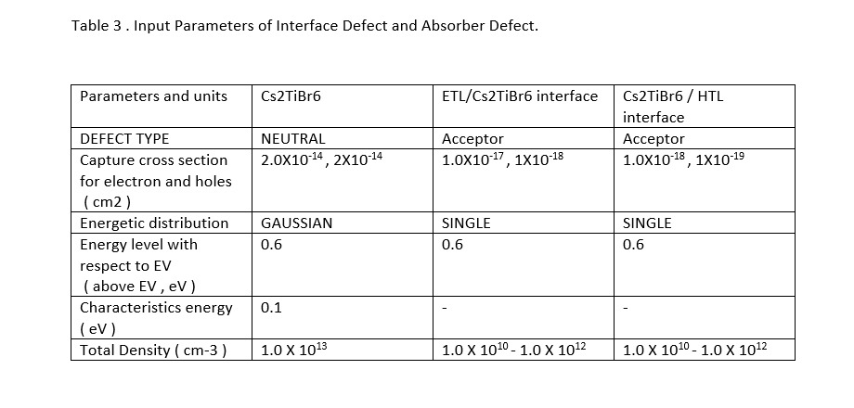
Simulation Setup and Parameter Changes

Slide 17
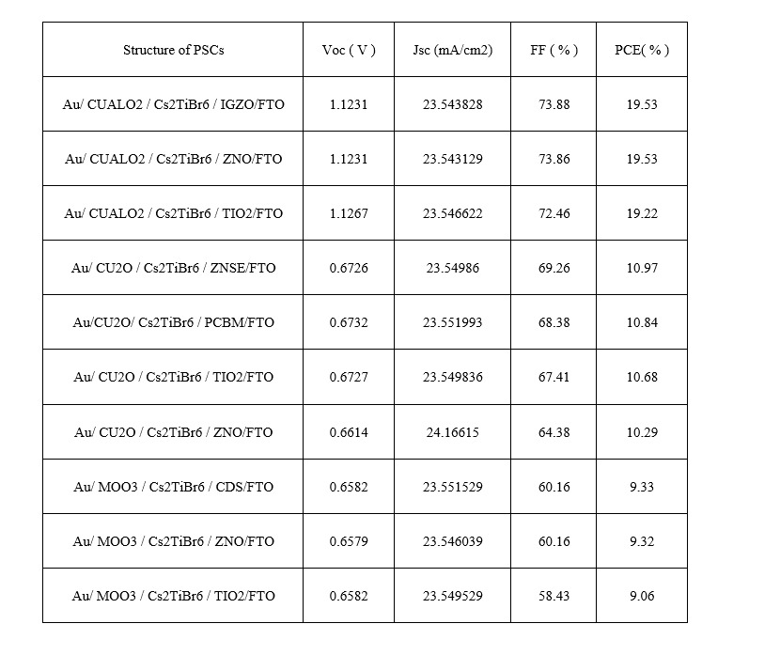
Results and Final Efficiency
Considering all optimization parameters, the Cs₂TiBr₆ based device achieved a maximum efficiency of 73.88%, with Voc of 1.1231 V, Jsc of 23.54 mA/cm², and FF of 19.53%.

Slide 18
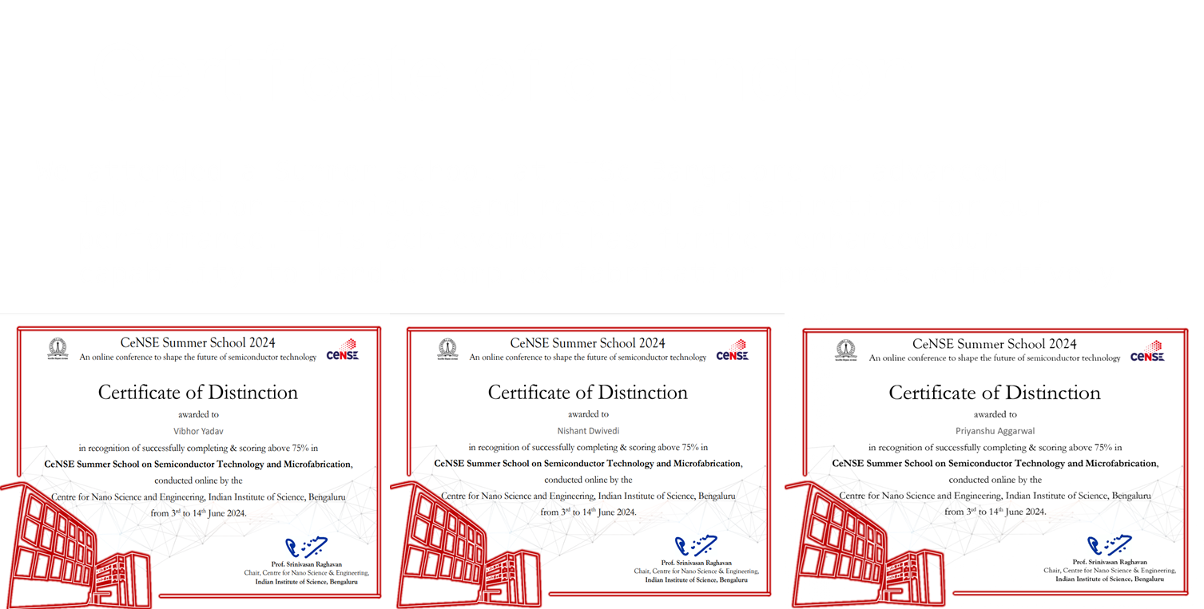
Certificates of Distinction
We attended a summer school at IISC Bangalore on Advanced fabrication techniques and received a Distinction for our performance . This Achievement has further enhanced our capability to handle comples fabrication projects effectively.

Slide 19

Results and Discussion
1. CH₃NH₃Pb(I₁₋ₓClₓ)₃
Efficiency: 24.98%
Challenges: Lead toxicity and instability under moisture and heat.
Discussion: High efficiency but environmental concerns and degradation limit long-term use.
2. CH₃NH₃SnBr₃
Efficiency: 27.26%
Challenges: Lower stability and efficiency.
Discussion: Lead-free alternative with lower performance and stability issues.
3. Cs₂TiBr₆
Efficiency: 19.53%
Challenges: Low efficiency, better stability.
Discussion: Stable, lead-free but requires efficiency improvements.

Slide 20
Conclusion
Optimizing perovskite solar cells is essential to fully realize their potential as a renewable energy source. While efficiencies over 25% have been achieved, challenges such as stability, moisture sensitivity, and lead toxicity need to be addressed for long-term viability.
Efforts to improve performance focus on enhancing material stability, developing lead-free alternatives, and fine-tuning halide compositions. Advances in encapsulation and fabrication techniques help protect cells from degradation.
With continued research and innovation, perovskite solar cells could become a cost-effective, high-efficiency, and environmentally friendly alternative to silicon-based cells, driving the future of sustainable energy.

Slide 21
References
Kojima, A.; Teshima, K.; Shirai, Y.; Miyasaka, T. Organometal Halide Perovskites as Visible-Light Sensitizers for Photovoltaic Cells. J. Am. Chem. Soc., 131, 6050–6056, (2009).
Burschka, J.; Pellet, N.; Moon, S.-J.; Humphry-Baker, R.; Gao, P.; Nazeeruddin, M.K.; Grätzel, M. Sequential deposition as a route to high-performance perovskite-sensitized solar cells. Nat. Cell Biol., 499, 316–319, (2013).
Yang, W.S.; Park, B.-W.; Jung, E.H.; Jeon, N.J.; Kim, Y.C.; Lee, D.U.; Shin, S.S.; Seo, J.; Kim, E.K.; Noh, J.H.; et al. Iodide management in formamidinium-lead-halide–based perovskite layers for efficient solar cells. Science, 356, 1376–1379.(2017).
N. Singh, A. Agarwal, and M. Agarwal, Study the effect of band offsets on the performance of lead-free double perovskite solar cell. Opt. Mater. 125, 11-12,(2022).
5.Miyata, A.; Mitioglu, A.; Plochocka, P.; Portugal, O.; Wang, J.T.-W.; Stranks, S.D.; Snaith, H.; Nicholas, R. Direct measurement of the exciton binding energy and effective masses for charge carriers in organic–inorganic tri-halide perovskites. Nat. Phys, 11, 582–587,(2015).

Slide 22
Thank You

